Slide 1
Housing Insecurity

Slide 2
Nearly half of LA County households are housing insecure, whether with or without children under 5
There are
153,864
households in L.A. County with children under 5 that spend 30% or more of income on rent or mortgage
Source: American Community Survey Public Use Microdata 1-Year Estimates, 2022 Note: Housing insecurity is defined as paying 30% or more of income on rent or mortgage.
Notes:
Talking Points:
…

Slide 3
Rates of housing insecurity have declined over the last ten years
Source: American Community Survey Public Use Microdata 1-Year Estimates, 2013-2022. No data were published for 2020 due to the pandemic. Note: Housing insecurity is defined as paying 30% or more of income on rent or mortgage.

Slide 4
Black and Latinx households with children under 5 are most likely to be housing insecure
Source: American Community Survey Public Use Microdata 5-Year Estimates, 2018-2022

Slide 5
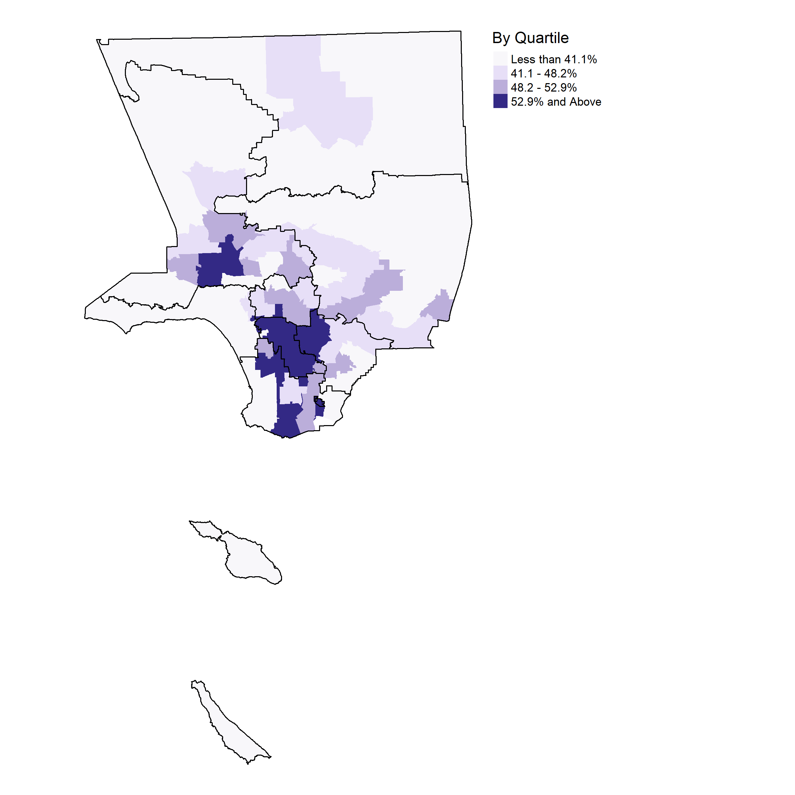
Percent of households with children under 5 that spend 30% or more of income on rent or mortgage
1
2
3
4
5
6
7
Not to scale
8
SPAs (2021) outlined and numbered
Source: American Community Survey Public Use Microdata 5-Year Estimates, 2021 Note: Housing insecurity is defined as paying 30% or more of income on rent or mortgage. Shaded areas are Public Use Microdata Areas (PUMAs), Census geographies of 100,000 people or more.
Notes:
PUMAs with an overlay of SPAs

